Slide 1
Final Project Facial Animation Retargeting using a Simple Machine Learning Technique
2018 Fall, GCT522, Computer Graphics Theory and Application
Sunjin Jung
2018-10-15

Slide 2
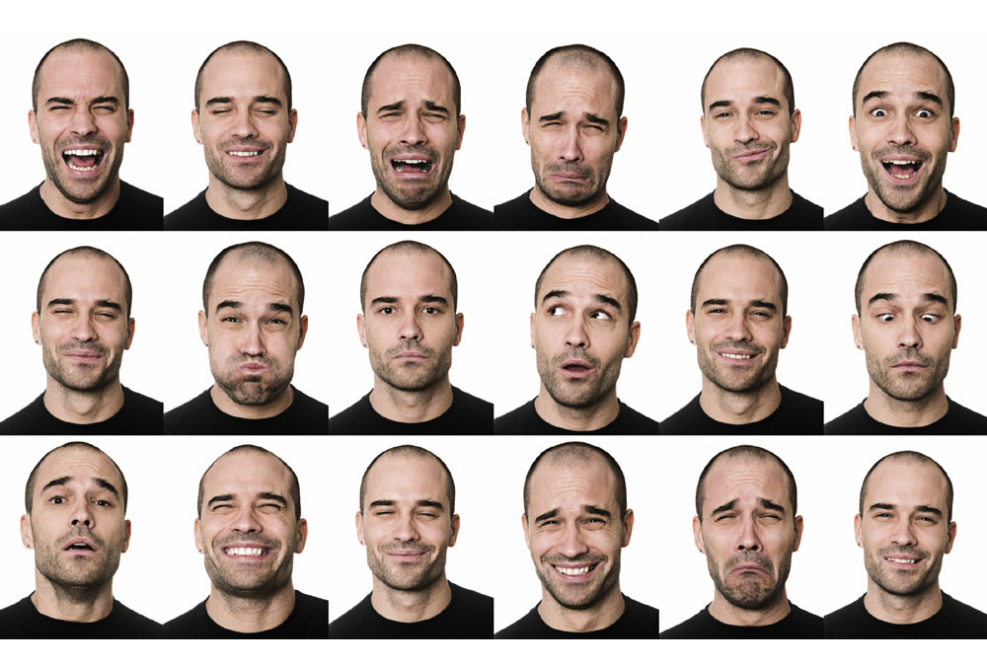
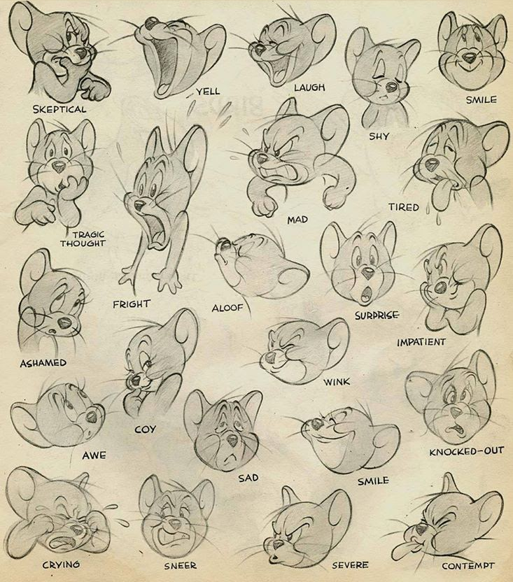
Motivation
Facial expression is most significant feature of human communication. [Albert Mehrabian, 1970]

Slide 3
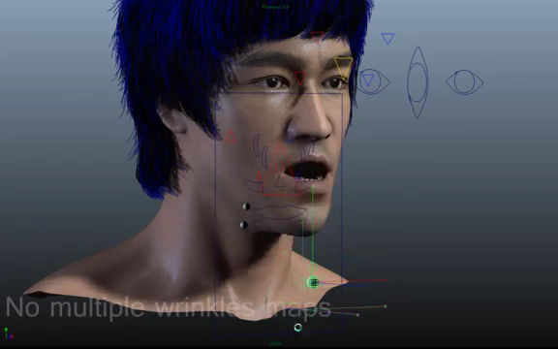
Motivation
Previous ways to make facial animation
Keyframing
http://youtu.be/jpvybyRstrI

Slide 4
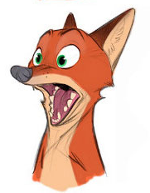
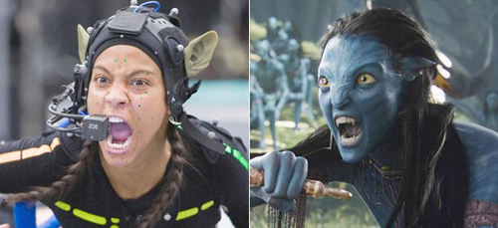
Motivation
Previous ways to make facial animation
Keyframing
Motion capture
Retargeting to non-humanoid character is hard
Retargeting
http://youtu.be/jpvybyRstrI

Slide 5
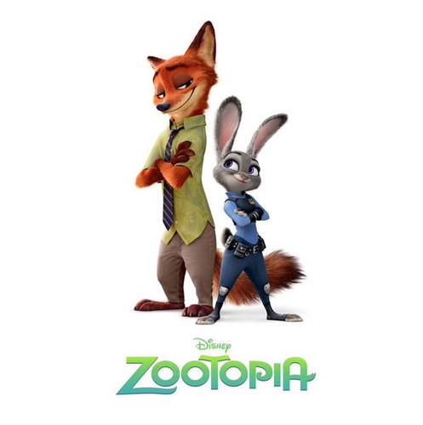
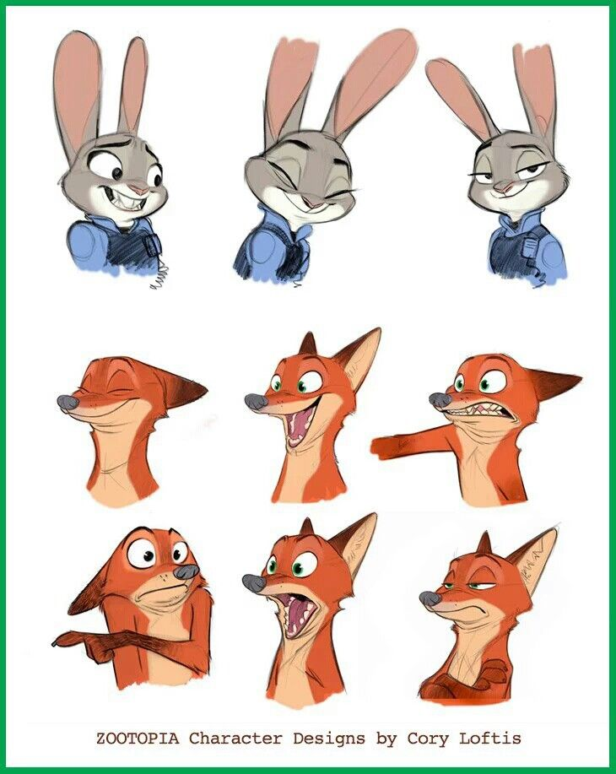
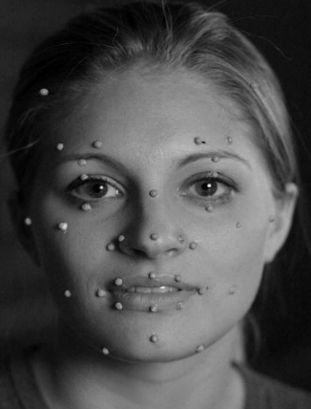
Goal
To generate various characteristic facial animations from a single motion data
...
Captured data
Retargeting
3D character
Sample animations

Slide 6
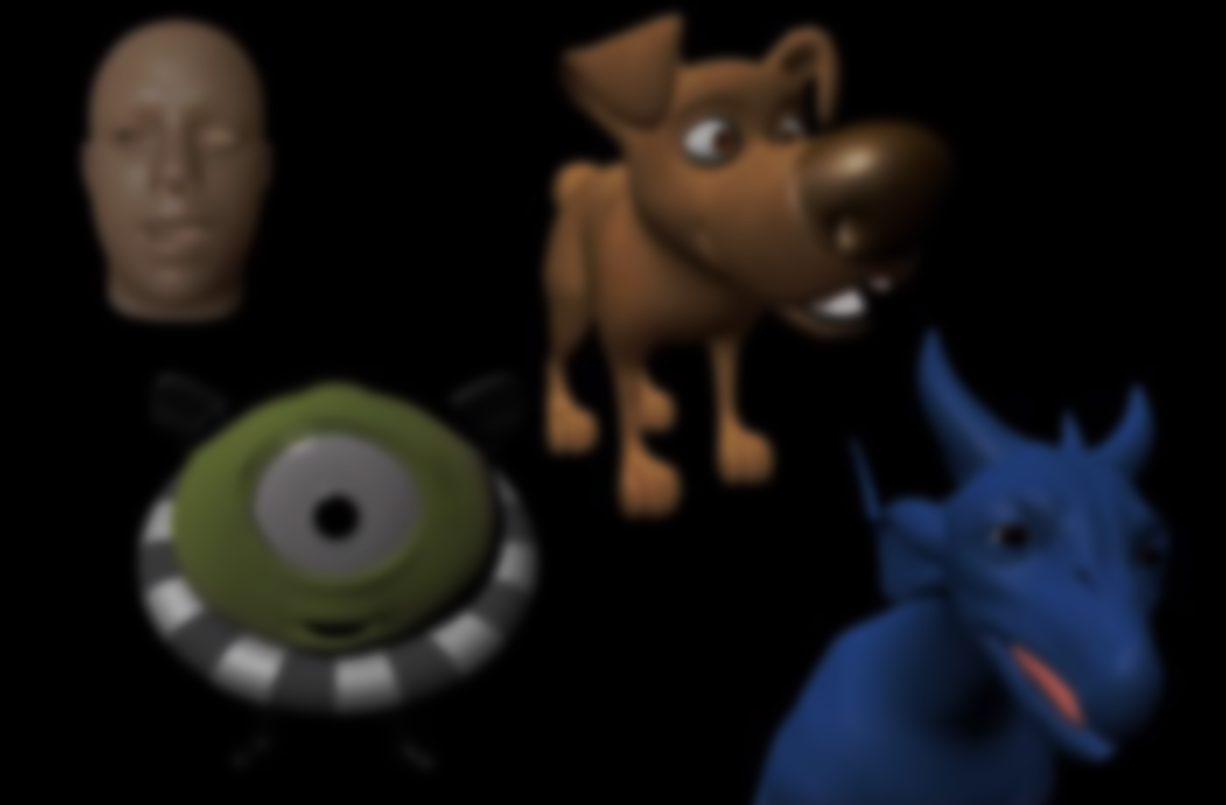
Characteristic Facial Retargeting
J. Song, B. Choi, Y. Seol, J. Noh
Journal of Computer Animation and Virtual Worlds, 2010

Slide 7
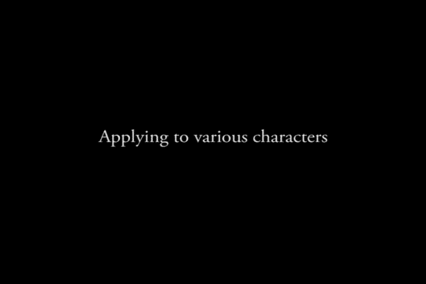
https://www.youtube.com/watch?v=1pCCH6iB_1U
Characteristic Facial Retargeting
J. Song, B. Choi, Y. Seol, J. Noh

Slide 8
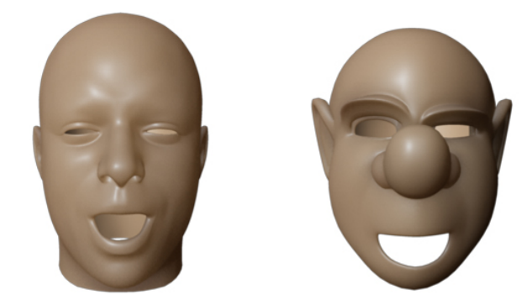
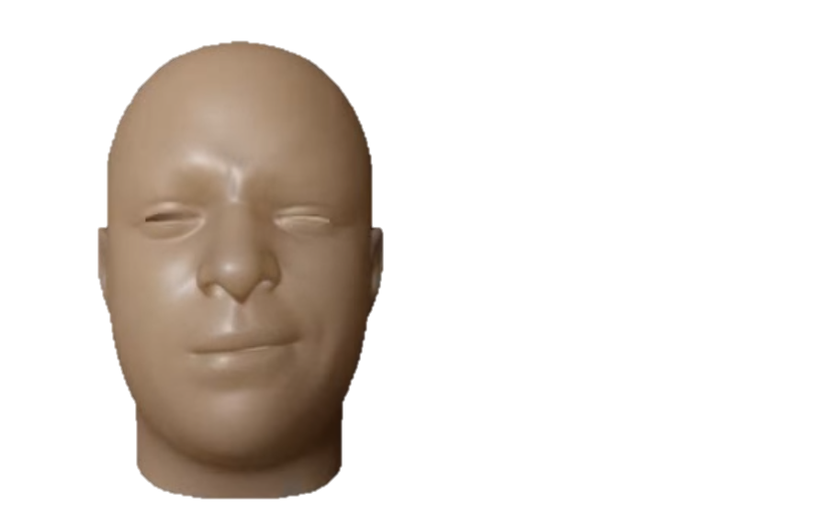
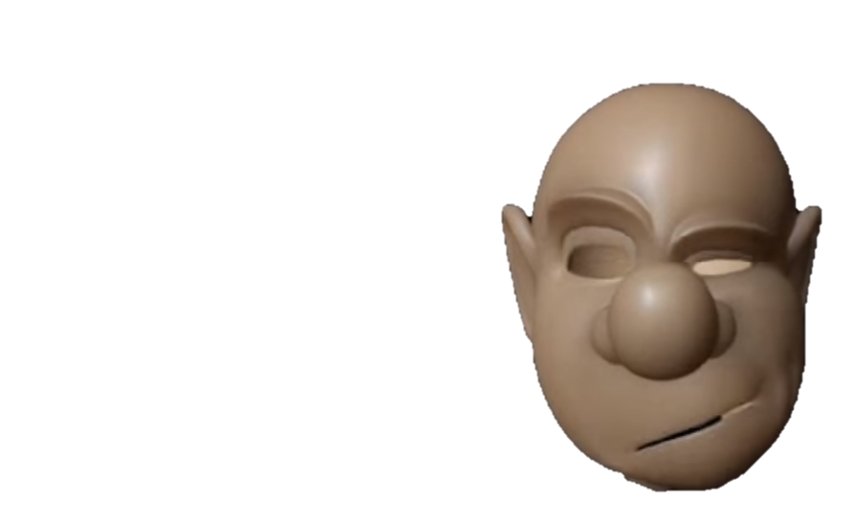
Retargeting
Data-driven approach
Training
...
...
Source model
Target model

Slide 9
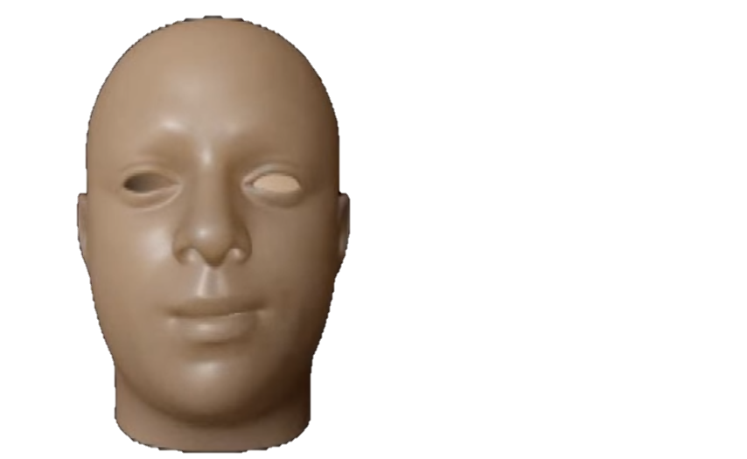
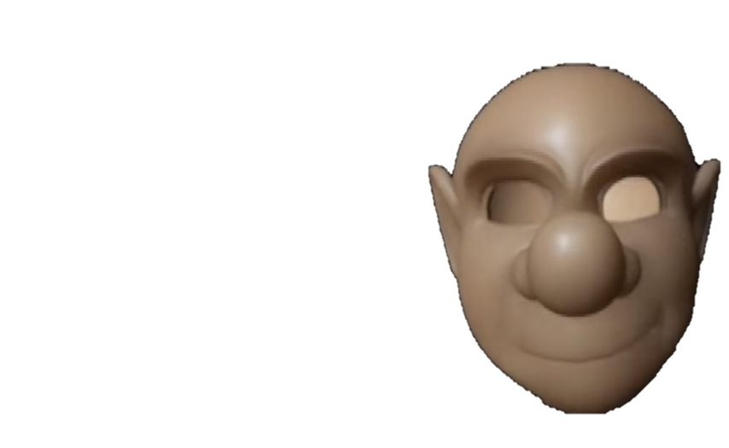
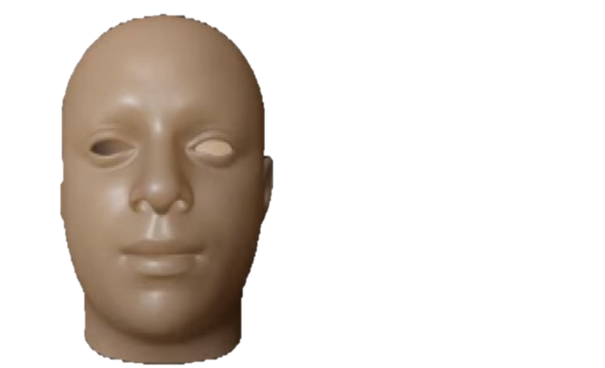
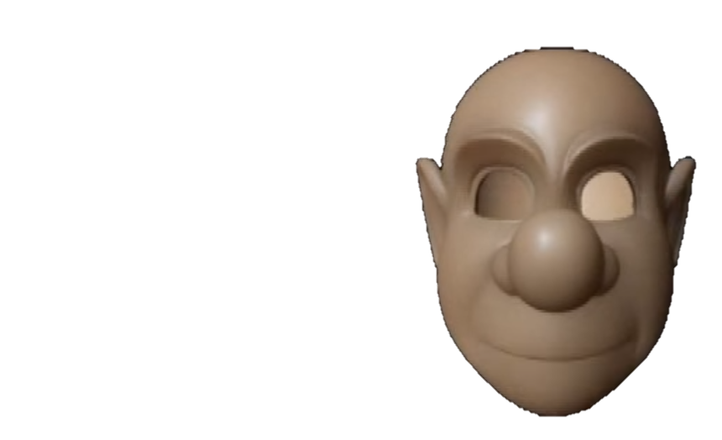
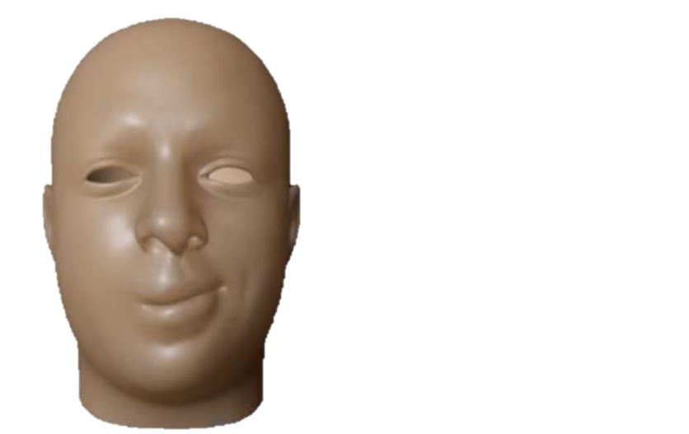
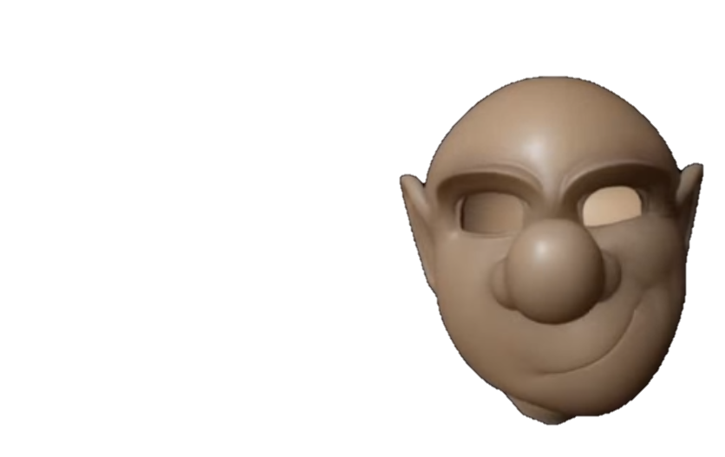
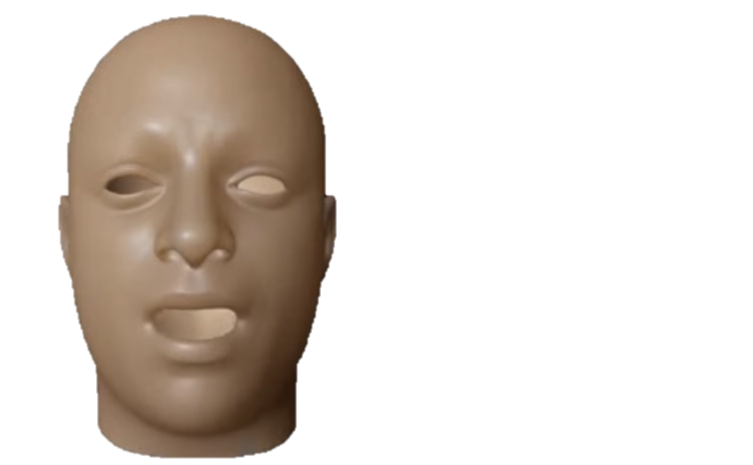
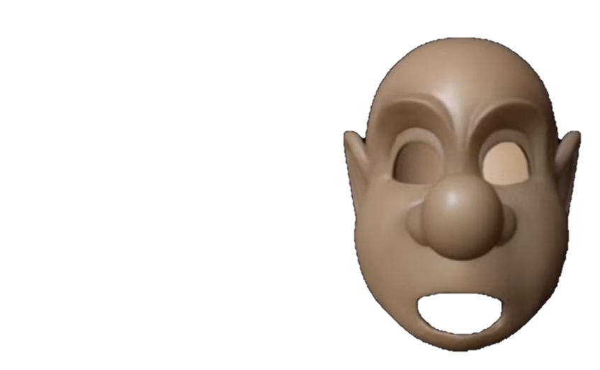
Retargeting
Expression pair
Source Expression Space
Target
Expression Space
S = (ws_1, ws_2, ws_3, ... , ws_ns)
ws : blendshape weight
T = (cv_1, cv_2, cv_3, ... , cv_nt)
cv : self defined general basis

Slide 10
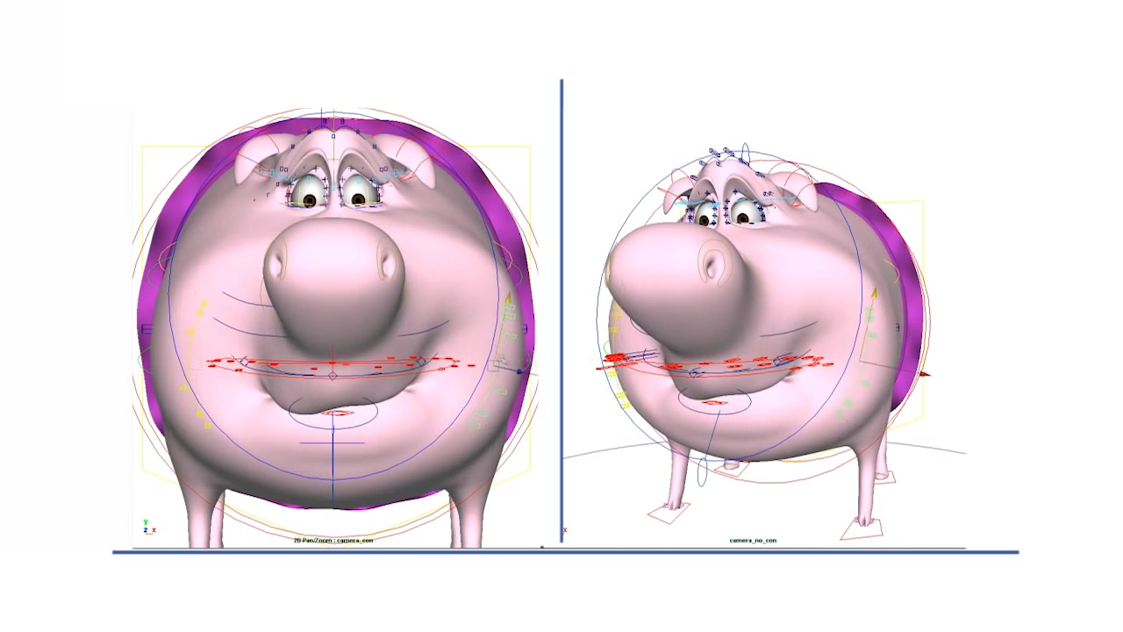
Retargeting
Control Vector
Joints
Deformers
Blendshapes
Controllers
...
General basis CVs
https://youtu.be/BMV5Jo7rB2E

Slide 11
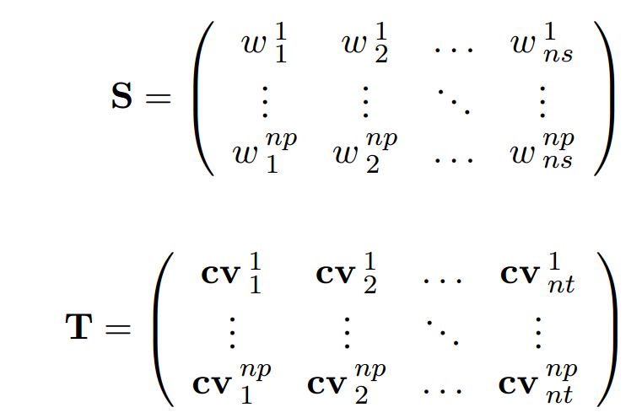
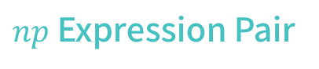
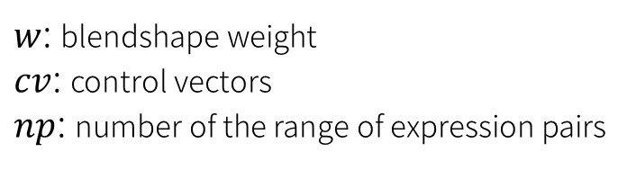
Retargeting
$np$ Expression Pair
...
...
$w$: blendshape weight
$cv$: control vectors
$np$: number of the range of expression pairs
Source Target

Slide 12
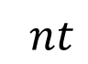
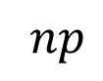
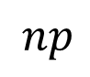
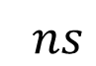
Retargeting
Retargeting model based on the regression
$$ns$$
$$nt$$
S
Model
T
$$np$$
$$np$$
New inputs
New targets

Slide 13
Retargeting
Retargeting model based on the regression
$$ns$$
$$nt$$
S
Model
T
$$np$$
$$np$$
RBF
Radial Basis Function

Slide 14
Grading Policy (30 Points)
Implementation
Output visual quality
Presentation
20 pts
5 pts
5 pts

Slide 15
The Given Framework
You are given source codes, with an already created framework. You have to complete the missing areas.
The code is commented and it is indicated where you need to complete the code.
Implement 4 Maya Commands and 1 Algorithm
Source Expression Pair Data Generation
FRR_blendExport.cpp FRRBlendExport –bn “blendNodeName.dat” –bfn “blend_ROE_FileName.dat” –f frameNumber
Target Expression Pair Data Generation
FRR_CVExport.cpp FRRCVExport –cln “CtrlListFileName.dat” “CV_ROE_FileName.dat” –f frameNumber
Target Final Result Animation Import
FRR_CVImport.cpp FRRCVImport -cln "kokoCtrlList.dat" -ffn "kokoFinalResult.dat"
Target Final Retargeting Data Generation
FRR_Training.cpp FRRTraining –bfn “Blend_ROE_FileName.dat” –cfn “CV_ROE_FileName.dat” –sfn “SourceFileName.dat”
RBF
rbfKernel.cpp (Radial Basis Function)

Slide 16
The Given Files
Source Pair Data Scene File
HumanBROE.mb (source range of expression Maya scene file)
Target Pair Data Scene File
kokoCROE.mb (target range of expression Maya scene file)
Target Controller List File
kokoCtrlList.dat (target facial rig controller list file)
Source Animation Data
humanSourceAnimation.mb (source animation for retargeting via RBF training)
Target Scene File
koko.mb (target character original Maya scene file)

Slide 17
Workflow
Export the source & target expression pairs, source animation
HumanBROE.mb, kokoCROE.mb, kokoCtrlList.dat, humanSourceAnimation.mb
Train RBF Model & Get the resulting target animation
Using created .dat files
Import the final target animation
koko.mb, kokoCtrlList.dat

Slide 18


Framework
※ (file) means given file.
FRR_BlendExport.cpp
FRR_CVExport.cpp
FRR_CVImport.cpp
(HumanROE.mb)
(kokoCROE.mb)
(kokoCtrlList.dat)
(koko.mb)
FRRBlendExport
FRRCVExport
FRRCVImport
Blend_ROE.dat
CV_ROE.dat
FRR_Training.cpp
FRRTraining
humanSourceData.dat
finalResult.dat

Slide 19
Framework
※ (file) means given file.
FRR_BlendExport.cpp
FRR_CVExport.cpp
FRR_CVImport.cpp
(HumanBROE.mb)
(koko.mb)
(HumanSourceAnimation.mb)
(kokoCROE.mb)
(kokoCtrlList.dat)
FRRBlendExport
FRRCVExport
FRRCVImport
Blend_ROE.dat
CV_ROE.dat
FRR_Training.cpp
FRRTraining
humanSourceData.dat
finalResult.dat

Slide 20
Framework
※ (file) means given file.
FRR_BlendExport.cpp
FRR_ctrlListExport.cpp
FRR_CVExport.cpp
FRR_CVImport.cpp
(HumanBROE.mb)
(kokoCROE.mb)
(kokoCtrlList.dat)
(koko.mb)
FRRBlendExport
FRRCVExport
FRRCVImport
Blend_ROE.dat
CV_ROE.dat
FRR_Training.cpp
FRRTraining
humanSourceData.dat
finalResult.dat

Slide 21
Framework
※ (file) means given file.
FRR_BlendExport.cpp
FRR_CVExport.cpp
FRR_CVImport.cpp
(HumanBROE.mb)
(kokoCROE.mb)
(kokoCtrlList.dat)
(koko.mb)
FRRBlendExport
FRRCVExport
FRRCVImport
Blend_ROE.dat
CV_ROE.dat
FRR_Training.cpp
FRRTraining
humanSourceData.dat
finalResult.dat

Slide 22
Framework
※ (file) means given file.
FRR_BlendExport.cpp
FRR_CVExport.cpp
FRR_CVImport.cpp
(HumanBROE.mb)
(kokoCROE.mb)
(kokoCtrlList.dat)
(koko.mb)
FRRBlendExport
FRRCVExport
FRRCVImport
Blend_ROE.dat
CV_ROE.dat
FRR_Training.cpp
FRRTraining
humanSourceData.dat
finalResult.dat

Slide 23
Framework
※ (file) means given file.
FRR_BlendExport.cpp
FRR_CVExport.cpp
FRR_CVImport.cpp
(HumanBROE.mb)
(kokoCROE.mb)
(kokoCtrlList.dat)
(koko.mb)
FRRBlendExport
FRRCVExport
FRRCVImport
Blend_ROE.dat
CV_ROE.dat
FRR_Training.cpp
FRRTraining
humanSourceData.dat
finalResult.dat

Slide 24
Framework
※ (file) means given file.
FRR_BlendExport.cpp
FRR_CVExport.cpp
FRR_CVImport.cpp
(HumanBROE.mb)
(kokoCROE.mb)
(kokoCtrlList.dat)
(koko.mb)
FRRBlendExport
FRRCVExport
FRRCVImport
Blend_ROE.dat
CV_ROE.dat
FRR_Training.cpp
FRRTraining
humanSourceData.dat
finalResult.dat

Slide 25
Framework
※ (file) means given file.
FRR_BlendExport.cpp
FRR_CVExport.cpp
FRR_CVImport.cpp
(HumanBROE.mb)
(kokoCROE.mb)
(kokoCtrlList.dat)
(koko.mb)
FRRBlendExport
FRRCVExport
FRRCVImport
Blend_ROE.dat
CV_ROE.dat
FRR_Training.cpp
FRRTraining
humanSourceData.dat
finalResult.dat

Slide 26
Framework
Video

Slide 27
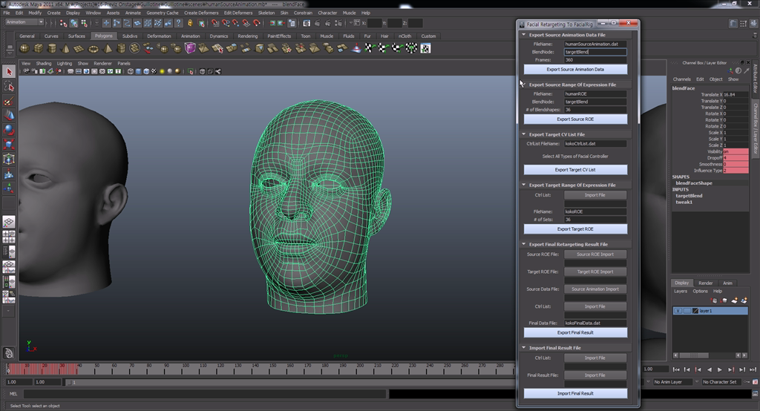
GUI
see supplementary videos

Slide 28
Score Break Down (Implementation : 20 Points)
User Interface 1 pts
GUI +1 pts
Data Generation 7 pts
FRR_blendExport.cpp +3 pts
FRR_CVExport.cpp +4 pts
RBF in RBFKernel.cpp/h 4 pts
rbfKernel.cpp +4 pts
Data out 8 pts
FRR_Training.cpp +4 pts
FRR_CVImport.cpp +4 pts

Slide 29
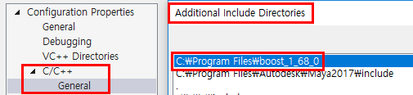
Etc.
You should use BOOST library for this project.
Boost download & build
https://www.boost.org/users/download/
https://codeyarns.com/2014/06/06/how-to-build-boost-using-visual-studio/
VS Project property
You can just add the boost_(version) file directory to the Additional Include Directories(C/C++ > General)
Ex)

Slide 30
Etc. (Output visual quality : 5 Points)
For the final demo, you can use your own source animation data or target character from the internet.
If you want to use a new target character, you need to keyframing for a range of expression corresponding the source ROE using controllers of the target character.
For a controller list file(.dat) of the new target character, you can use ‘FRRCtrlListExport’ command(given code) after selecting the controllers(See the supplementary video about this process).
You can also make your own source animation by key-framing to make the final demo video.

Slide 31
Etc.
Read the paper
Characteristic Facial Retargeting
http://vml.kaist.ac.kr/main/international/individual/41
Do your homework #4 (Blendshape)
Do this final project

Slide 32
Final Project
Due date
23:00, Sunday, Dec. 9th, 2018
Submission files
1) Source code: sln / .cpp / .h / .vcproj … (To reduce size please clean your solution)
2) UI code: .py file
3) compiled binary file : .mll file
4) output video files
5) presentation materials
6) readme file: Target Machine & software (ex. Maya 17 x64)
How to use your Command (if you don’t provide UI)
Demonstration policy
You should present your project! Prepare some nice demo video :-)

Slide 33
Q/A
Sunjin Jung
sunjin225@kaist.ac.kr
#2344, N5 Building / Visual Media Lab. in GSCT

